Slide 1

MAHARASHTRA STATE BOARD OF TECHNICAL EDUCATION Certificate
This is to certify that Mr. HUSSAIN ARSIWALA , ABDURRAHMAN QURESHI , Ansari Saad Mohd. Arif , MORE ARYA LAXMAN , KAZI ADNAN WASIM. Roll No. 210448 , 210451 , 210453 , 210460 , 210463 of 1ST Semester of Diploma in COMPUTER ENGINEERING of Institute M. H. SABOO SIDDIK POLYTECHNIC (Code: 0002) has completed the term work satisfactorily in course WORKSHOP PRACTICE for the academic year 2021 to 2022 as prescribed in the curriculum.
Place: MUMBAI Enrolment No: 2100020104 , 2100020112 , 2100020102 , 2100020097 , 2100020117
Date: Exam. Seat No:
SUBJECT: WORKSHOP PRACTICE TEACHER: KOUSAR AYUB AKUMALLA , MUNIRA ANSARI H.O.D. : MS. ZEBUNNISA MALIK
PRINCIPAL: DR. A.K. KURESHI
SEAL OF INSTITUTE

Slide 2
WEEK 1: MICRO-PROJECT IS ALLOTED TO THE GROUP-----[1 HOUR]
WEEK 2: INFO. REGARDING PROJECT IS GATHERED-----[1 HOUR]
WEEK 3: WORK IS DIVIDED AMONG THE GROUP MEMBERS---[1 HOUR]
WEEK 4: INDIVIDAUL INFORMATION IS COLLECTED---[1 HOUR]
WEEK 5: INDIVIDUAL PICTURES AND GRAPHS ARE COLLECTED---[1 HOUR]
WEEK 6: INDIVIDUALLY COLLECTED INFO. IS ENTERED IN PPT---[1 HOUR]
WEEK 7: INDIVIDUAL WORKS ARE COMPILED---[1 HOUR]
WEEK 8: PPT IS COMPILED---[1 HOUR]
WEEK 9: PPT IS SHOWN---[1 HOUR]
WEEK 10: MADE CHANGES AS INSTRUCTED---[1 HOUR]
WEEK 11: ALL CERTIFICATE AND ANNEXURE ARE COMPILED--[1 HOUR]
Total Time: 3hours

Slide 3
annexure
Evaluation sheet for the micro project
Academic Year: 2021-2022 Name of Faculty: Mrs. Kousar Ayyub Akumalla
Course: Computer Engineering Course code:22005 Semester: 1
Title of the project: Types of Wires , Cables , Switches & Light Sources
Cos addressed by Micro project: a, b, d

Slide 4
Major learning outcomes achieved by students by doing the Project:
(a)Practical Outcomes:
______________________________________________________________________________________________________________________________
(b)Unit outcomes in Cognitive domain:
______________________________________________________________________________________________________________________________
(c) Outcomes in effective domain:
______________________________________________________________________________________________________________________________

Slide 5
WPC LOG FOR MICRO-PROJECT Name: HUSSAIN ARSIWALA , ABDURRAHMAN QURESHI , ANSARI SAAD MOHD. ARIf , MORE ARYA LAXMAN , ADNAN KAZI WASIM. ROLL NO : 210448 , 210451 , 210453 , 210460 , 210463

Slide 6
NAME & SIGNATURE OF FACULTY:
Roll no. | Student Name | Marks out of 6 for performance in group activity | Marks out of 4 for performance in oral/ presentation | TOTAL MARKS OUT OF 10
210448 | HUSSAIN ARSIWALA
210451 | ABDURRAHMAN QURESHI
210453 | ANSARI SAAD MOHD. ARIF
210460 | MORE ARYA LAXMAN
210463 | ADNAN KAZI WASIM

Slide 7
Types of wires:

Slide 8
What is a wire:-
A wire is a single usually cylindrical, flexible strand or rod of metal. Wires are used to bear mechanical loads or electricity and telecommunications signals. Wire is commonly formed by drawing the metal through a hole in a die or draw plate. The purpose of the wires in a series circuit is to allow the electricity to flow from one device to the next.
There are five types of wires :-

Slide 9
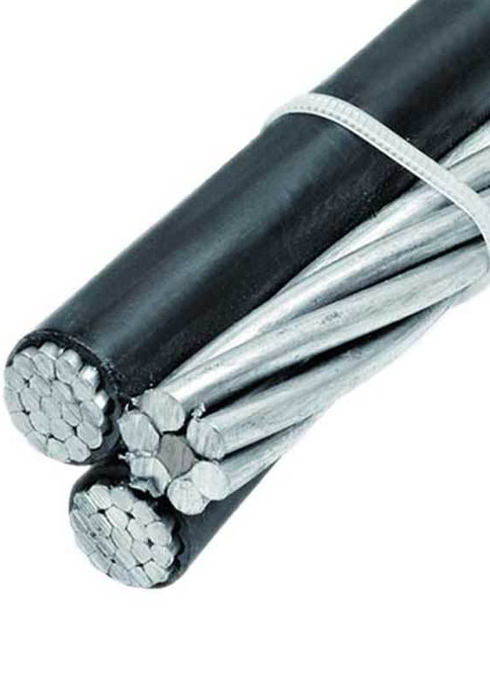
Triplex Wires:
Triplex wires are usually used in single-phase service drop conductors, between the power pole and weather heads. They are composed of two insulated aluminium wires wrapped with a third bare wire which is used as a common neutral. The two insulated conductors are called the "hot" legs of the service while the bare (uninsulated) wire is the neutral wire of the service.

Slide 10
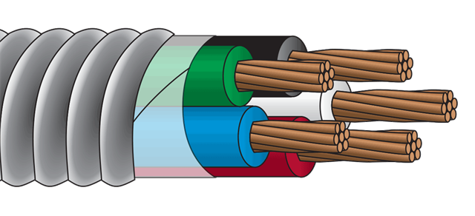
Main Feeder Wires:
Main power feeder wires are the wires that connect the service weather head to the house. They’re made with stranded or solid THHN wire and the cable installed is 25% more than the load required.

Slide 11
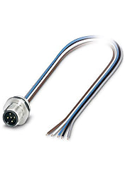
Panel Feed Wires:
Panel feed cables are generally black insulated THHN wire. Just like main power feeder wires, the cables should be rated for 25% more than the actual load. The black wire is the "hot" wire, it carries the electricity from the breaker panel into the switch or light source. The white wire is the "neutral" wire, it takes any unused electricity and current and sends it back to the breaker panel.

Slide 12
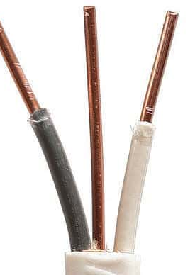
Non-Metallic Sheathed Wires:
Non-metallic sheath wire, or Romex, is used in most homes and has 2-3 conductors, each with plastic insulation, and a bare ground wire. The individual wires are covered with another layer of non-metallic sheathing. Since it’s relatively cheaper and available in ratings for 15, 20 and 20 amps, this type is preferred for in-house wiring.

Slide 13
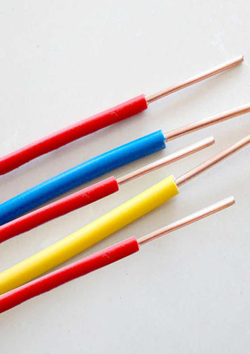
Single Strand Wires:
Single strand wire also uses THHN wire, though there are other variants. Each wire is separate and multiple wires can be drawn together through a pipe easily. Single strand wires are the most popular choice for layouts that use pipes to contain wires. It is useful for wiring breadboards. Single strand wire is cheaper to manufacture than stranded wire and is used where there is little need for flexibility in the wire.

Slide 14
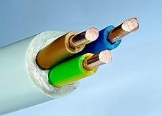
cable
A cable assembly is the composition of one or more electrical cables and their corresponding connectors. [1] A cable assembly is not necessarily suitable for connecting two devices but can be a partial product (e.g. to be soldered onto a printed circuit board with a connector mounted to the housing). Cable assemblies can also take the form of a cable tree or cable harness, used to connect many terminals together.

Slide 15
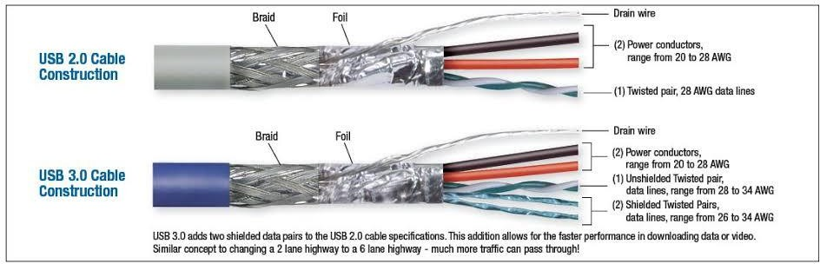
usb
THE TERM USB STANDS FOR "UNIVERSAL SERIAL BUS". USB CABLE ASSEMBLIES ARE SOME OF THE MOST POPULAR CABLE TYPES AVAILABLE, USED MOSTLY TO CONNECT COMPUTERS TO PERIPHERAL DEVICES SUCH AS CAMERAS, CAMCORDERS, PRINTERS, SCANNERS, AND MORE. USB •USB cables are "Hot Pluggable", in other words you can connect and disconnect the cables while the computer is running without fear of freezing the computer. USB cables are fast, transferring up to 480Mbps. Compare that to serial communication which transfers data at about 20Kbps

Slide 16
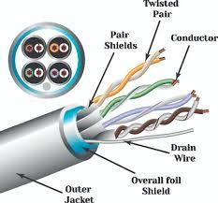
Shielded cable
A shielded cable or screened cable is an electrical Cable of one or more insulated conductors enclosed by a common conductive layer. The shield may be composed of braided strands of copper (or other metal, such as aluminum), a non-braided spiral winding of copper tape, or a layer of conducting polymer.

Slide 17
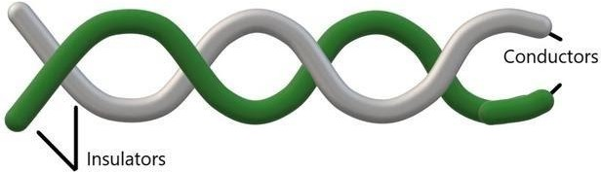
Twisted pare
These are a type of guided media. It was invented by Alexander Graham Bell. Twisted pair cables have two conductors that are generally made up of copper and each conductor has insulation. These two conductors are twisted together, thus giving the name twisted pair cables.

Slide 18
Types of Switches:

Slide 19

Switches
A switch is an electrical component that can disconnect or connect the conducting path in an electrical circuit, interrupting the electric current or diverting it from one conductor to another.[1][2] The most common type of switch is an electromechanical device consisting of one or more sets of movable electrical contacts connected to external circuits. When a pair of contacts is touching current can pass between them, while when the contacts are separated no current can flow.

Slide 20
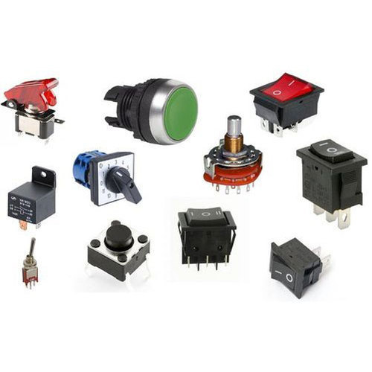
Different types of switches
Switches are made in many different configurations; they may have multiple sets of contacts controlled by the same knob or actuator, and the contacts may operate simultaneously, sequentially, or alternately. A switch may be operated manually, for example, a light switch or a keyboard button, or may function as a sensing element to sense the position of a machine part, liquid level, pressure, or temperature, such as a thermostat. Many specialized forms exist, such as the toggle switch, rotary switch, mercury switch, push-button switch, reversing switch, relay, and circuit breaker. A common use is control of lighting, where multiple switches may be wired into one circuit to allow convenient control of light fixtures. Switches in high-powered circuits must have special construction to prevent destructive arcing when they are opened.

Slide 21
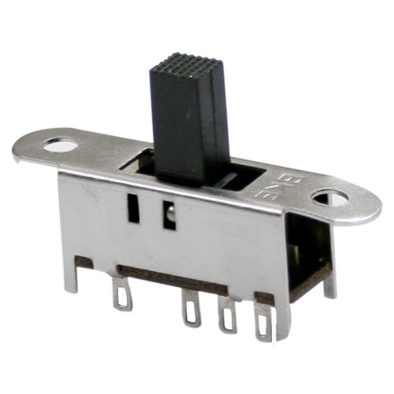
Slide switches
Slide switches are mechanical switches using a slider that moves (slides) from the open (off) position to the closed (on) position.

Slide 22
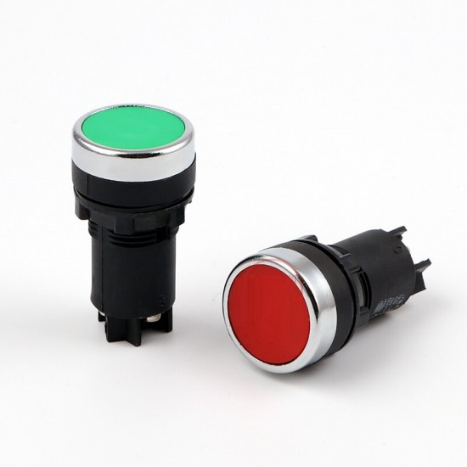
Push button switches
A Push Button switch is a type of switch which consists of a simple electric mechanism or air switch mechanism to turn something on or off. Depending on model they could operate with momentary or latching action function. … This means that when a button is pressed it can cause another button to release.

Slide 23
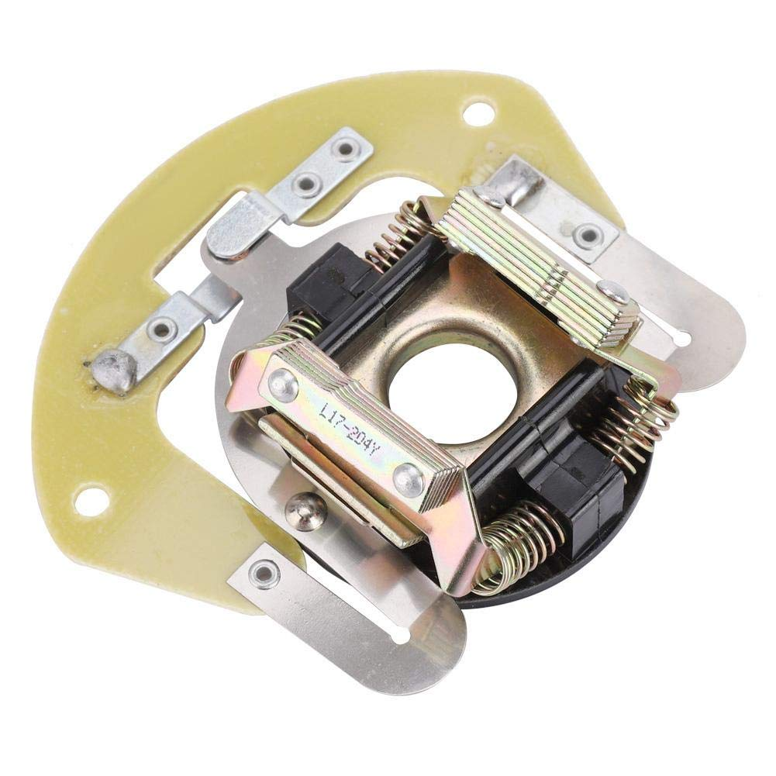
Centrifugal switch
A centrifugal switch is an electric switch that operates using the centrifugal force created from a rotating shaft, most commonly that of an electric motor or gasoline engine. The switch is designed to activate or de-activate as a function of the rotational speed of the shaft

Slide 24
Light sources:

Slide 25
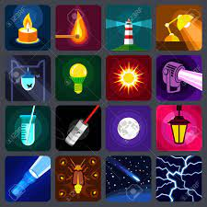
Light sources
A light source is anything that makes light. There are natural and artificial light sources. A few examples of natural light sources include the Sun, stars and candles. A few examples of artificial light sources include light bulbs, lamp posts and televisions.

Slide 26
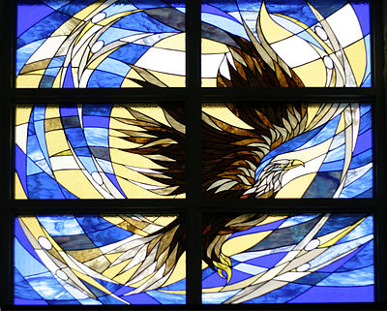
Non- luminous objects
Most objects do not produce light on their own. Objects are able to be seen because light reflects (bounces off) them to our eyes.
Colored liquids and stained glass windows allow light to pass through them and this allows us to see the objects.
Objects that we see because light reflects from them or passes through them are called non-luminous sources of light.

Slide 27
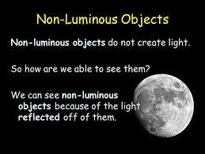
Luminous sources of light
Luminous Sources of Light can be both natural and artificial.
Natural sources of light are those that produce light without human intervention.
Sun, Northern Lights, glow of red-hot lava

Slide 28
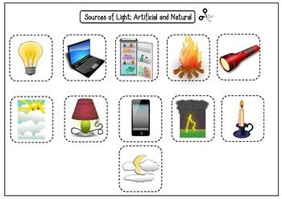

Slide 29
light
Light is produced when other forms of energy (heat or chemical) are converted into light energy.
Luminous objects produce light are:
• Incandescence
• Electric Discharge
• Fluorescence and Phosphorescence
• Chemiluminescence
• Bioluminescence
• Triboluminescnce
• Light Emitting Diode (LED)

Slide 30
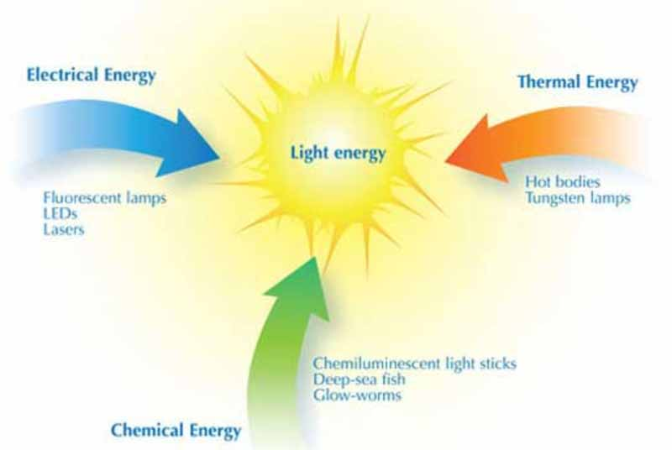

Slide 31
WEEK 1: MICRO-PROJECT IS ALLOTED TO THE GROUP-----[1 HOUR]
WEEK 2: INFO. REGARDING PROJECT IS GATHERED-----[1 HOUR]
WEEK 3: WORK IS DIVIDED AMONG THE GROUP MEMBERS---[1 HOUR]
WEEK 4: INDIVIDAUL INFORMATION IS COLLECTED---[1 HOUR]
WEEK 5: INDIVIDUAL PICTURES AND GRAPHS ARE COLLECTED---[1 HOUR]
WEEK 6: INDIVIDUALLY COLLECTED INFO. IS ENTERED IN PPT---[1 HOUR]
WEEK 7: INDIVIDUAL WORKS ARE COMPILED---[1 HOUR]
WEEK 8: PPT IS COMPILED---[1 HOUR]
WEEK 9: PPT IS SHOWN---[1 HOUR]
WEEK 10: MADE CHANGES AS INSTRUCTED---[1 HOUR]
WEEK 11: ALL CERTIFICATE AND ANNEXURE ARE COMPILED--[1 HOUR]
Total Time: 3hours

